Slide 1

Oman Academic Accreditation Authority
Program Accreditation Project:
A Progress Report
Dr Janice Ross
Quality Assurance Consultant

Slide 2
الهيئة العمانية للاعتماد الأكاديمي
مشروع الاعــــتماد البــرنامجي
(تقريــــــــــر مرحلي)
الدكتورة جانيس روس
مستشارة ضمان جـــــودة

Slide 3
Overview of Presentation
OAAA
Milestones
Program Standards Assessment (PSA) Pilots
Learning from the Pilots
Actions and updates
Consultation
Next steps and future milestones

Slide 4
نظرة عامة على العرض
OAAA
المحطــــات الرئيسية
عمليات التقويم التجريبية مقابل المعايير البرنامجية
الدروس المستفادة من عمليات التقويم التجريبية
الإجراءات المتخذة والتحديثات
المشاورات
الخطوات المستقبلية والمحطات الرئيسية القادمة

Slide 5

Major Milestones 2013-2016
OAAA
Date
October 2013 | National Symposium
October 2013 | Draft Program Standards Conceptual Design Framework (CDF) (v1.2)
October 2013 | Draft Program Standards 1-9 (v1.2)
March 2014 | Briefing on Institutional and Program Standards Assessment: Approach to decision-making
September 2014- July 2015 | Program Standards Assessment Pilots
November 2015 | Updated Program Standards CDF
November 2015 | Revised Program Standards 1-6 (v2); initial approval by OAAA Board February 2016
November 2015-February 2016 | Further stakeholder consultation on updated CDF and revised Program Standards
Notes:
This project began in June 2016.
As you can see, there have been a number of significant milestones in the development of the Conceptual Design Framework for Program Accreditation, and also in the development of the Program Standards.
In today’s presentation, I would like to focus on some of the more recent milestones – the Pilots undertaken as part of the project, and what OAAA has learned from these important activities.

Slide 6
المحطات الرئيسية 2013-2016
OAAA
 | التاريخ
ندوة وطنية | أكتوبر 2013
مسودة «إطار تصميم المفاهيم» للمعايير البرنامجية (نسخة 1.2) | أكتوبر 2013
مســـودة المعايير البرنامجية 1-9 (نسخة 1.2) | أكتوبر 2013
عرض (مؤتمر) حول التقويم مقابل المعايير المؤسسية والبرنامجية: النهج المتّبع في اتخاذ القرارات. | مــارس 2014
عمليات التقويم التجريبية مقابل المعايير البرنامجية | سبتمبر 2014- يوليو 2015
تعديل المعايير البرنامجية | نوفمبر 2015
النسخة المعدلة من المعايير البرنامجية 1-6 (نسخة 2). اعتماد أولي من قبل مجلس إدارة الهيئة- فبراير 2016 | نوفمبر 2015
مزيد من التشاور مع الجهات ذات العلاقة حول إطار تصميم المفاهيم والنسخة المعدلة من المعايير البرنامجية | نوفمبر 2015- فبراير 2016

Slide 7

Program Standards Assessment (PSA) Pilots
OAAA
A small-scale test of a research instrument …used to test the utility of the research design
Test appropriateness of the draft Program Standards (v1.2)
Test feasibility of the PSA methodology (CDF v2.0)
Gather formal and informal feedback from the HEIs and Panel members
Observe and reflect
Notes:
“Any small-scale test of a research instrument [in this case, Program Standards Assessment]…used to test the utility of the research design” (www.encyclopedia.com accessed 3/9/2016)
A pilot is a trial/experiment, to test how good something is, prior to full-scale implementation
To test the research process or protocol ie a feasibility study because the pilot study tests how possible the design is in reality. For example, are the resources adequate to undertake the research/exercise? Are there any other logistical problems that need to be addressed? (http://study.com/academy/lesson/what-is-a-pilot-study-definition-example.html accessed 3/9/2016)

Slide 8
التقويم مقابل المعايير البرنامجية-
العمليات التجريبية
OAAA
اختبار مصغر لأداة بحث ... (لاختبار جدوى تصميم البحث)
اختبار ملاءمة مسودة المعايير البرنامجية (نسخة 1.2)
اختبار جدوى/فاعلية النهج المتبع في التقويم مقابل المعايير البرنامجية (إطار تصميم المفاهيم، نسخة 2.0)
جمع التغذية الراجعة الرسمية وغير الرسمية من مؤسسات التعليم العالي وأعضاء فرق التدقيق التجريبي.
المتابعة والتفكير

Slide 9

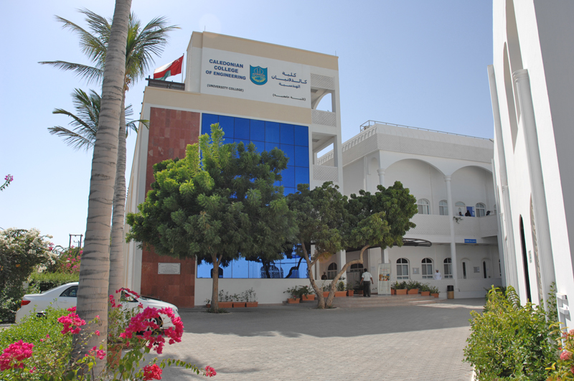
Caledonian College of Engineering
OAAA
BSc (Honours) Computer Aided Mechanical Engineering
Degree awarded by UK university
Externally accredited by IET
Key dates
  PSAA submitted October 2014
  Visit December 2014
  Report approved by OAAA Board July 2015
Notes:
For OAAA the choice of pilot institutions was important, so that the pilots could work with a range of institutions, types of program, and academic disciplines that reflect the diversity within the Omani higher education sector
CCE is a University College, based in Muscat
The PSA evaluated a single program, with two exit points (Diploma; and BSc Honours). The program is one of 4 undergraduate programs offered by the Department of Mechanical and Industrial Engineering. (This is important, as one of the learning points included the need consider how the standards and criteria need to be worded to reflect the reality of an academic department managing a number of programs falling within a cognate area). Also, the experience of this pilot highlighted the potential methodological and pragmatic benefits of evaluating a cluster of programs in a cognate discipline area, rather than one program in isolation.
2nd Bullet: Glasgow Caledonian University, Scotland (ie a ‘foreign program’)
3rd Bullet: Institution of Engineering and Technology (ie an externally accredited program)

Slide 10
كلية كاليدونيان الهندسية
OAAA
بكالوريس (شرف) في الهندسة الميكانيكية المدعومة بالكمبيوتر
الشهادة تمنحها جامعة من المملكة المتحدة
معتمدة خارجيا من قبل مؤسسة الهندسة والتكنولوجيا IET
المحطات الرئيسية:
  أكتوبر 2014: تقديم طلب التقويم مقابل المعايير البرنامجية
  ديسمبر 2014: زيارة التقويم
  يوليو 2015 : اعتماد التقرير من قبل مجلس إدارة الهيئة.

Slide 11

Dhofar University
(College of Commerce and Business Administration)
OAAA
BA in Business Administration
6 Majors (Accounting; Finance; Insurance; Management; Marketing; Management Information Systems)
Key dates
  PSAA submitted October 2014
  Visit March 2015
  Report approved by OAAA Board July 2015
Notes:
Dhofar University, based outside Muscat and in Salalah in the south of Oman.
Academic discipline of Business
One program, but with a number of specified Majors

Slide 12
جامعة ظفار (كلية التجارة وإدارة الأعمال)
OAAA
بكالوريس آداب في إدارة الأعمال
6 تخصصات (محاسبة- مالية – تأمين – إدارة – تسويق – إدارة أنظمة المعلومات)
المحطات الرئيسية:
  أكتوبر 2014: تقديم طلب التقويم مقابل المعايير البرنامجية
  مارس 2015: زيارة التقويم
  يوليو 2015 : اعتماد التقرير من قبل مجلس إدارة الهيئة.

Slide 13

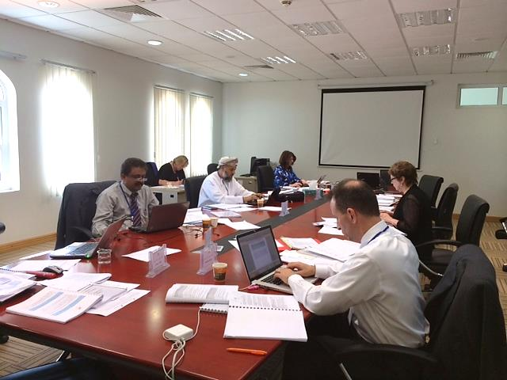
Pilot PSA Panel Members
OAAA
Notes:
It is worth saying a little about the Pilot Panels.
Here are some photographs of the Panel for the Dhofar University Pilot
The Panel members were selected from OAAA’s Register of External Reviewers; they included both locally-based reviewers and international reviewers
Two of the panel members were also members of the international panel of experts who had commented on early versions of the CDF and Program Standards….so in a sense they have been with OAAA throughout its journey in the development of the system for Program Accreditation
Several Panel members had experience of working with international accreditation bodies, either as panel members for those bodies and/or as academic managers of their own programs undergoing external accreditation
Each pilot was managed by a OAAA Executive Officer, and additionally each pilot had an OAAA Observer (independent of the process, and an additional means of gathering feedback and reflection)

Slide 14
The Learning Value of the Pilots
OAAA
Constructive feedback received throughout the pilot process
      During the planning stages
      At the end of the visit
      During preparation and finalisation of the reports
      At the end of the pilot process (formal evaluation questionnaires)
Feedback included:
      ‘What works well’
      ‘Areas for improvement’
Notes:
The feedback received highlighted many positive aspects of the draft PSA process and program standards. These identified ‘what works well’ and, therefore, should be retained and built upon.
The emphasis here (in this presentation) has been placed on the identification of areas for further development or improvement, in order to demonstrate the significant value to the OAAA of the pilots.

Slide 15
فوائـــــد عمليات التقويم التجريبية
OAAA
الحصول على تغذية راجعة بناءة طوال العملية التجريبية:
  في مراحل التخطيط
  في نهاية الزيارة عند إعداد التقارير ووضعها في صيغتها النهائية
  في نهاية عملية التقويم التجريبية (استبيان رسمي لتقويم العملية)
شملت التغذية الراجعة:
  الجوانب التي تعمل بشكل جيد
  الجوانب القابلة للتحسين

Slide 16


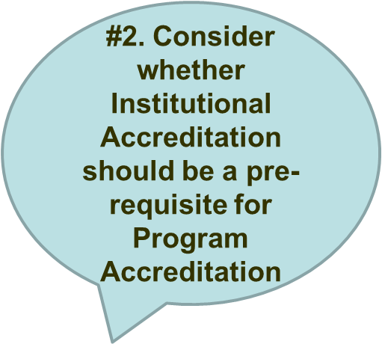
What OAAA learned from the Pilots (1)
OAAA
#3. The scope of the Program Standards (v1.2) was too wide
Notes:
The identification of areas for further development or improvement were as follows (10 points):
There is a need to draw a clearer distinction between program matters and institutional matters. The PSA process should devote more time to the deeper consideration of program-level activities, by leaving what was considered to be institutional matters for Institutional Accreditation.
Related to this, some panel members considered that Institutional Accreditation should be a pre-requisite for Program Accreditation.
The scope of the Program Standards (as set out in v1.2) was too wide, with the draft criteria drawing away attention from the ‘centre of gravity’ of the program, and away from program-level matters; the balance of emphasis between program and institutional matters needs to be considered again.

Slide 17
الدروس المستفادة من
التقويم التجريبي (1)
OAAA
ضرورة وجود فصل واضح بين المسائل المتعلقة بالبرامج الأكاديمية والمسائل المؤسسية.
التفكير في إمكانية جعل الاعتماد المؤسسي متطلبا (شرطا مسبقا) للاعتماد البرنامجي.
نطاق المعايير البرنامجية (نسخة 1.2) كان واسعا جدا.

Slide 18
Learning points from the Pilots (2)
OAAA
#4 Need to clarify the wording of some Program Standards and Criteria
#5 Need to be more ‘outcome-focused’ (what students and graduates of the program achieve)
#6 Need greater focus on ‘technical evaluation’ (academic/professional aspects)
Notes:
Both the HEIs and panel members gave detailed feedback on individual Program Standards and Criteria; Revision and/or clarification of the detailed wording of some Criteria was suggested. For example, there were some 30+ Criteria identified by the Panels where greater clarification of meaning for the HEI and/or Panel was desirable; the HEIs (in particular CCE) also provided feedback on 40+ Criteria.
Related to this need to focus more specifically on the program, the PSA process needs to be more outcome-focused, ie focused on what current students on the program, and graduates of the program, are achieving;
Also, a greater focus on ‘technical evaluation’, i.e. consideration of the academic discipline and/or profession, was also seen to be important.

Slide 19
الدروس المستفادة من
التقويم التجريبي (2)
OAAA
ضرورة توضيح نصوص بعض المعايير والمقاييس.
ضرورة أن تركز المعايير والمقاييس أكثر على المخرجات (ما يحقّقه طلبة البرنامج وخرّيجوه).
ضرورة التركيز بشكل أكبر على «التقويم الفني» (الجوانب الأكاديمية والمهنية).

Slide 20
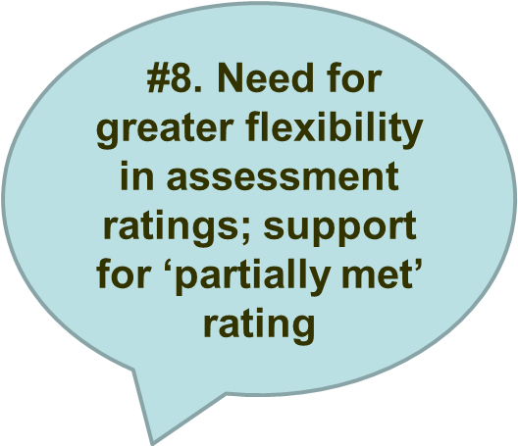
Learning points from the Pilots (3)
OAAA
#7. Consider further how to optimise the use of the Panel’s time
#10. Provide more guidance to HEIs on the evidence to be made available to panels during visits
#9. Need to better define some key terms
Notes:
The need to better define certain terms, for example, ‘international students’ and ‘student placements’
The need for greater flexibility in the ratings scheme, and how accreditation outcomes are arrived at; support for the notion of a ‘partially met’ rating.
In general, the Program Standards Assessment process was seen to work well. Within that context, the Assessment Visit schedule, visit activities, and the optimal use of the Panel’s time were identified as areas for further consideration.
The need to provide more guidance to HEIs on the quantity and quality of evidence to be made available to Panel’s during the Visit (for example, module/course information; samples of students’ assessed work)

Slide 21
الدروس المستفادة من
التقويم التجريبي (3)
OAAA
التفكير أكثر في الاستخدام الأمثل لوقت فرق التقويم
الحاجة إلى هامش أكبر من المرونة في التقديرات مقابل المقاييس، ودعم فكرة إدراج تقدير «مستوفى جزئيا»
الحاجة إلى تعريفات أكثر دقة لبعض المصطلحات الرئيسية
توفير مزيد من التوجيه للمؤسسات حول الوثائق/الأدلة التي تقدمها لفرق التقويم أثناء الزيارات.

Slide 22

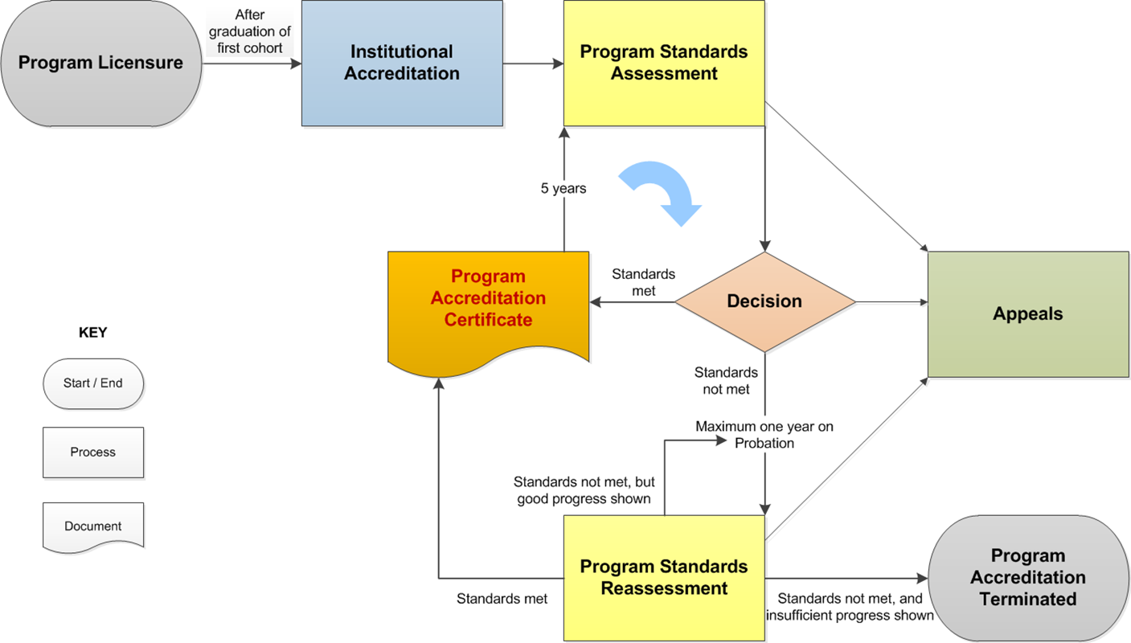

Actions arising from the Pilots (1)
OAAA
Notes:
The following are the main developments to the Program Accreditation Project, arising from the learning points from the pilots, combined with earlier feedback from stakeholder consultation activity:
A change in the pre-requisites for Program Accreditation, so that institutional accreditation is a pre-requisite for program accreditation (see diagram)
OAAA also considers that, in some circumstances, it may also be appropriate for Program Standards Assessment to take place concurrently with Institutional Standards Assessment. This was approved by the OAAA Board in May 2015. How this will operate will be addressed in the draft Manual.

Slide 23
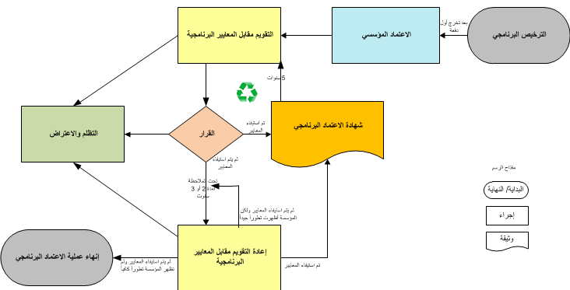
القرارات المنبثقة عن
التقويم التجريبي (1)
OAAA
متطلب

Slide 24
Actions arising from the Pilots (2)
OAAA
Revision of the scope of the Program Standards (now draft v2.0)
Six standards (55 criteria)
Revision of the detailed wording of the program Standards, Criteria and Indicators
Standard 1 | Program Governance and Management
Standard 2 | Coursework program Design and Delivery
Standard 3 | Research Program Design and Delivery
Standard 4 | Engagement with Industry, Employers and the Professions
Standard 5 | Academic Support and Student Support Services
Standard 6 | Program Staff and Staff Support Services
Notes:
A revision in the scope of the program standards, to more explicitly focus on program-related matters, approved in principle by the OAAA Board in May 2015
The proposed scope of the revised Program Standards means that there are now six standards (in v1.2, the proposal was for nine standards).
Within the six program standards, there are some 55 Criteria (previously 75 Criteria in v1.2). As any given program will EITHER address Standard 2 OR Standard 3, that means the program will have to address 45 criteria (if a taught/coursework program) OR 40 Criteria (if a research program).
The revision the scope of the Standards has also been an opportunity to look again at internationally benchmarked good practice in the management of program academic standards and quality, and to introduce a number of new Criteria to reflect that good practice. For example, there are now three Criteria covering different aspects of assessment, including on the regulation of academic standards, pedagogic approaches and feedback to students on their assessment; a new Criterion on student induction has also been developed.
The revision of the detailed wording of Program Standards (and Criteria and Indicators) to create draft Program Standards v2: There has been significant revision of the Program Standards and Criteria. In developing the draft Program Standards v2, OAAA has been mindful of the need to make the criteria more outcome-focused (versus process-focused), for example in relation to graduate attributes and employability. Greater emphasis has also been placed on the setting and maintenance of academic standards for the program, including the development of intended learning outcomes (correspondingly, the curriculum) appropriate for the academic discipline and/or profession.

Slide 25
القرارات المنبثقة عن
التقويم التجريبي (2)
OAAA
حـــاكمية البرنامج وإدارته | المعيار 1
تصميم وتنفيذ البرامج المقدمة بطريقة المقررات الدراسية | المعيار 2
تصميم وتنفيذ البرامج المقدمة بطريقة المقررات البحثية | المعيار 3
المشـــاركة مع القطاعات الصناعية والمهنية وأرباب العمل | المعيار 4
الدعم الأكاديمي وخدمات الدعم الطالبي | المعيار 5
موظفو البرنامج وخدمات الدعم الوظيفي | المعيار 6
مراجعة نطاق المعايير البرنامجية (مسودة النسخة 2.0)
6 معايير (55 مقياسا)
مراجعة الصياغة اللغوية للمعايير والمقاييس والمؤشرات

Slide 26
Actions arising from the Pilots (3)
OAAA
Revision of the assessment model for PSA, including the use of the ‘partially-met’ rating (to align fully with that for ISA)
Confirmation that recognition of foreign programs will be subsumed within OAAA Program Accreditation
Ongoing development of the Program Standards Assessment Manual
Ongoing development of the OAAA Glossary
Notes:
The revision of the assessment model for PSA, in alignment with the model for Institutional Standards Assessment.
The confirmation that recognition of foreign programs will be subsumed within OAAA Program Accreditation:
The development of the PSA Manual: Drafting the Manual is currently underway (a set of milestones and a timeline have been developed to manage this work) and a number of the areas identified above are being considered in the drafting of the Manual (for example, the PSA visit schedule, visit activities; and optimal use of a panel’s time; and guidance to HEIs on the quality and quantity of evidence required of them).
The development of an OAAA-wide Glossary (for all its audit and standards assessment methods (both online, and in each Manual). Consultation exercises, plus the operation of the PSA pilots, has helped to identify some 54 terms which should be included in the Glossary, to assist HEIs in their preparations for Program Standards Assessment.

Slide 27
القرارات المنبثقة عن
التقويم التجريبي (3)
OAAA
مراجعة نموذج التقويم ، بما في ذلك إدراج تقدير «مستوفى جزئيا»؛ لمطابقة تقديرات المعايير البرنامجية مع تقديرات المعايير المؤسسية.
التأكيد على إدراج الاعتراف بالبرامج الأجنبية ضمن الاعتماد البرنامجي للهيئة.
العمل جار على تطوير دليل التقويم مقابل المعايير البرنامجية
العمل جار على تطوير مسرد مصطلحات الهيئة.

Slide 28

Further stakeholder consultation on updated CDF and revised Program Standards
November 2015 – February 2016
OAAA
Al Buraimi University College
Bayan College
Caledonian College of Engineering
Higher College of technology
Ibra Nursing Institute
Institute of Health Sciences
International Maritime College Oman
Middle East College
Muscat College
Salalah College of Technology
Sultan Qaboos University
Waljat College
Ministry of Health (Office of the Undersecretary for Planning Affairs; and Directorate General of Human Resources Development)
Ministry of Higher Education (Office of the Undersecretary; and Directorate General of Private Universities and Colleges)
Ministry of Manpower (Office of the Undersecretary for Technological Education and Vocational Training)

Slide 29
الاستشارة الموسّعة مع
الجهات ذات العلاقة
OAAA
بخصوص النسخ المعدلة من إطار تصميم المفاهيم والمعايير البرنامجية (نوفمبر 2015 – فبراير 2016)
كلية البريمي الجامعية – كلية البيان – كلية كالدونيان الهندسية – الكلية التقنية العليا – معهد التمريض بإبرا – معهد العلوم الصحية – الكلية البحرية الدولية – كلية الشرق الأوسط – كلية مسقط – الكلية التقنية بصلالة – جامعة السلطان قابوس – كلية ولجات – وزارة الصحة (مكتب سعادة الدكتور وكيل الوزارة لشئون التخطيط والمدير العام للموارد البشرية والتطوير) – وزارة التعليم العالي (مكتب سعادة الدكتور وكيل الوزارة والمديرية العامة للجامعات والكليات الخاصة) – وزارة القوى العاملة (مكتب سعادة الدكتورة وكيلة الوزارة للتعليم التقني والتدريب المهني)

Slide 30
Consultation Feedback (#1)
OAAA
Overall, feedback positive about the proposed developments to the Program Accreditation CDF and draft Program Standards
Institutional Accreditation as a pre-requisite for Program Accreditation:
  Majority of feedback supportive
  Clarification required of how ISA and PSA may take place concurrently (PSA Manual)
  Some diversity of opinion
Support that recognition of foreign programs is subsumed within OAAA Program Accreditation

Slide 31
التغذية الراجعة من الاستشارة (1)
OAAA
التغذية الراجعة في عمومها كانت إيجابية حول المقترحات المتعلقة بتطوير إطار تصميم المفاهيم ومسودة المعايير البرنامجية.
الاعتماد المؤسسي متطلب للاعتماد البرنامجي:
  غالبية الردود تؤيد المقترح
  الحاجة إلى توضيحات بخصوص إجراء العمليتين بشكل متزامن.
  بعض التنوع في الآراء
دعم لمقترح أن يكون الاعتراف بالبرامج الأجنبية ضمن عملية الاعتماد البرنامجي من قبل الهيئة.

Slide 32
Consultation Feedback #2
OAAA
Revision of the assessment model for PSA (‘partially met’)
  Majority of feedback supportive (‘useful’; ‘fair’; ‘motivating’)
  Should some criteria be more important than others?
  How to ensure that HEIs/programs have improvement plans?
Questions about policy:
  Relationship between OAAA Program Accreditation and accreditation by external accrediting bodies
  Program Accreditation fees

Slide 33
التغذية الراجعة من الاستشارة (2)
OAAA
مراجعة المنهج المتبع في التقويم وإدراج تقدير «مستوفى جزئيا»:
  غالبية الردود تؤيد المقترح ( مفيد – عادل – محفز)
  النظر في إمكانية المفاضلة بين المعايير (بعضها أهم من البعض الآخر؟)
  كيف نضمن وجود خطط تحسين للمؤسسات /البرامج؟
اسئلة تتعلق بسياسة الهيئة:
  العلاقة بين الاعتماد البرنامجي للهيئة العمانية للاعتماد الأكاديمي والاعتماد من قبل هيئات اعتماد خارجية؟
  رسوم الاعتماد البرنامجي؟

Slide 34
Consultation Feedback #3
OAAA
Questions about methodology and operational matters:
  How will Program Standards Assessment work with clusters/suites of programs in the same department? (Program Accreditation Manual)
  Evidence requirements (eg the time-span for data) (Program Accreditation Manual)
  Defining key terms (OAAA Glossary)
Feedback on specific standards and criteria
  Further clarification required on where MSc programs may ‘sit’ in Standards 2 and/or 3
Notes:
Feedback on all 6 standards and some 12 criteria (coverage; detailed wording)

Slide 35
التغذية الراجعة من الاستشارة (3)
OAAA
أسئلة حول المنهجية والمسائل العملية:
  كيف سيجري التقويم مقابل المعايير البرنامجية في حالة تقويم عدد من البرامج في نفس القسم؟ (أنظر دليل التقويم مقابل المعايير البرنامجية)
  متطلبات الإثبات: (مثلا المدى الزمني لللبيانات المطلوبة) (أنظر الدليل)
  تعريف المصطلحات الأساسية: (مسرد مصطلحات الهيئة)
ملاحظات حول معايير أو مقاييس محدّدة:
  هل سيتم تقويم برامج ماجستير العلوم (MSc) تحت المعيار الثاني أو الثالث؟

Slide 36

Next steps and future milestones
OAAA
Draft Program Accreditation Manual (PAM)
Circulate to stakeholders for consultation w/b 27 March 2016
Request feedback by 17 April 2016 (3 weeks)
PAM draft v2 by end April 2016
Briefing for HE sector by end April 2016

Slide 37
الخطوات القادمة والمحطّات المستقبليّة
OAAA
إعداد مسودة دليل التّقويم مقابل المعايير البرنامجيّة
توزيع المسودة على الجهات ذات العلاقة للحصول على التغذية الراجعة (انطلاقا من 27 مارس 2016)
طلب التغذية الراجعة بتاريخ 17 أبريل 2016 (3 أسابيع)
إعداد النسخة الثانية من الدليل مع نهاية أبريل 2016
اجتماع مع قطاع التعليم العالي مع نهاية أبريل 2016.

Slide 38

www.oaaa.gov.om

